Slide 1
Lesson 12 - Example: Drawing Lines
Mr Mack 2019

Slide 2
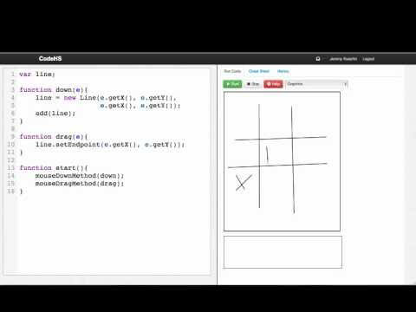

Slide 3
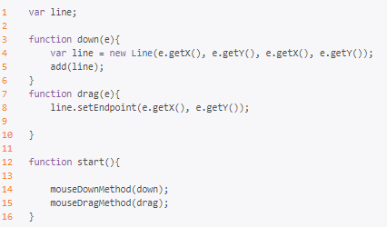
This code from the video draws lines on the canvas when the mouse is pressed down and dragged. But there is one problem. What is wrong with the following code?
Lines 14 and 15 are registering the mouse events incorrectly
Line 5 adds a line to the screen every time the mouse is down, but we need a line added before any mouse events
Line 4 declares a new local variable var line. The local variable line in down is different from the global variable line in drag, but we need these functions to be affecting the same line
None, there is no problem

Slide 4
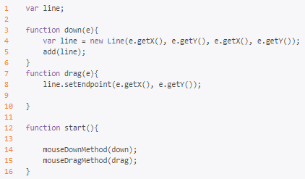
How do we fix this problem? The same code is shown again for reference:
Change Line 14 to
mouseDownMethod(down(e));
and change Line 15 to
mouseDragMethod(drag(e));
Get rid of the var in Line 4 so that the line in down refers to the same global line in drag rather than a local variable.
Move Line 5 to Line 13 so the line object is added before any mouse events happen.
No fix needed, there is no problem

Slide 5
Example: Drawing Lines
This is an example for this lesson. You are encouraged to play around with it, run and change the code, and learn how it works. When you are done, click continue to go to the next problem.

Slide 6
Exercise 3.12.1: Leash
Write a program that draws a ball connected to a line. The line should start out in the center of the screen, and the ball should be centered on the line’s endpoint. (This is also at the center at the beginning of the program)
When the user moves the mouse, you should set the endpoint of the line and the ball’s location to the location of the mouse, as if the ball is on a leash.

